Slide 1
Pixnapping Linux
Ashwin Nimmal

Slide 2
Security Definitions: Side Channel
Information leaked from a target system which can be used to infer sensitive data
E.g. timing, power usage, cache accesses, acoustic emissions

Slide 3
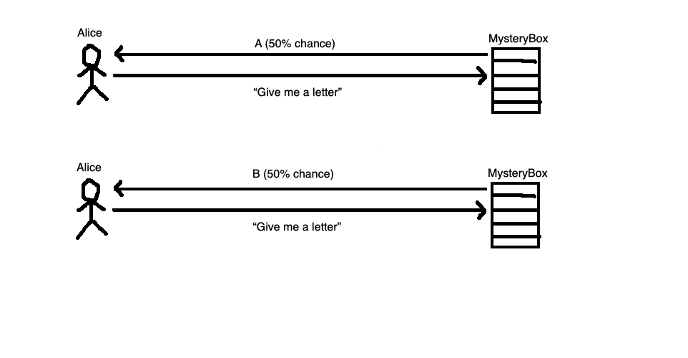
Timing Side-Channel Attack

Slide 4
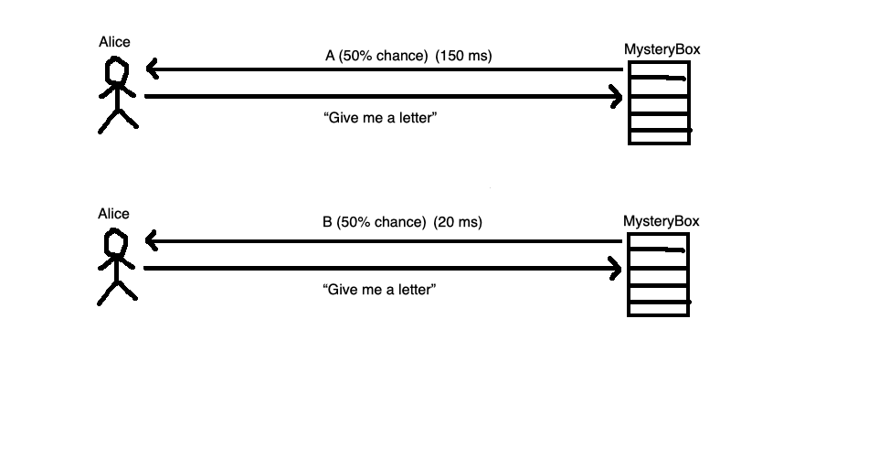
Timing Side-Channel Attack

Slide 5
Pixel Stealing Attacks
Type of timing side-channel attack
Utilizes color-dependent timing differences in graphical transformations
First fleshed out by Paul Stone in 2013 using iframes and SVG filters

Slide 6
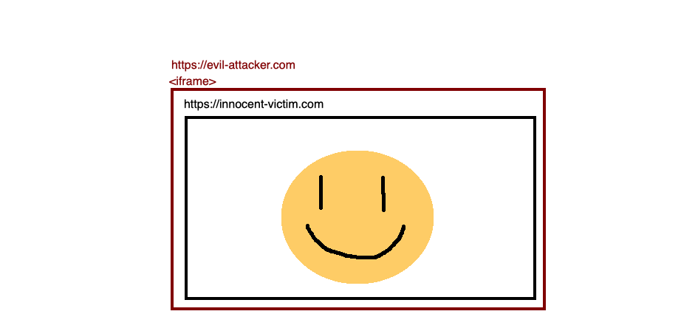
Pixel Stealing Attacks

Slide 7
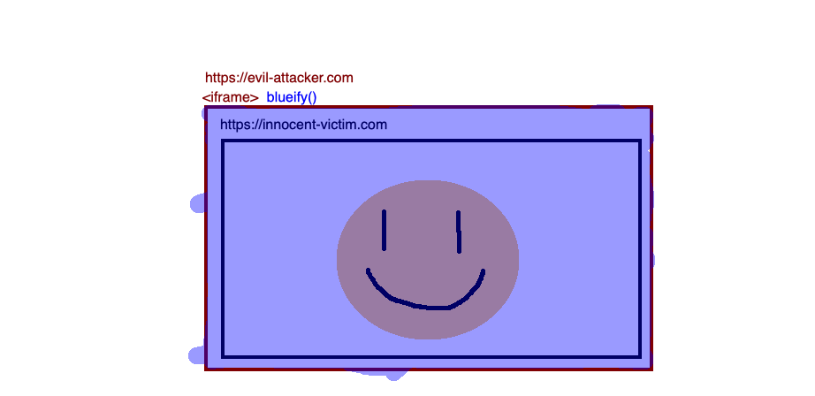
Pixel Stealing Attacks

Slide 8
Pixel Stealing Attacks
It takes 200ms to blueify a yellow pixel
It takes 40ms to blueify a black pixel

Slide 9
Stone-style Pixel Stealing Attack Structure
Embed victim website in iframe
Apply graphical transformations to individual pixels in iframe
Measure side channels from computation to infer pixel data

Slide 10
State of the Art: Pixnapping Android
Expansion of browser-based pixel stealing attacks
Pixel stealing attack on smartphones running Android operating system
Utilizes GPU.zip side channel with Android API
Can infer pixel data from any application

Slide 11
GPU.zip Side Channel
GPU compresses graphical frames for DRAM performance
Compression algorithm uses data-dependent compression ratio
Results in data-dependent DRAM traffic and data-dependent rendering time

Slide 12
Pixnapping Attack Structure
Use OS mechanisms to invoke rendering pipeline
Somehow perform a computation on individual pixels in victim application
Measure side channel to infer pixel values

Slide 13
Invoke Rendering Pipeline
Android allows inter-app interactions via “intents”
Can be used to submit frames to be rendered
Attacker app stealthily embeds victim app in itself on victim app launch
Uses intents to invoke rendering pipeline

Slide 14
Compute on Individual Pixels
Most complex part
Isolate individual pixels
Enlarge the pixels
Perform computation
Feed to side channel

Slide 15
Measure side channel
Application natively measures side channel
Can be any code
Infer pixel values from side channel

Slide 16
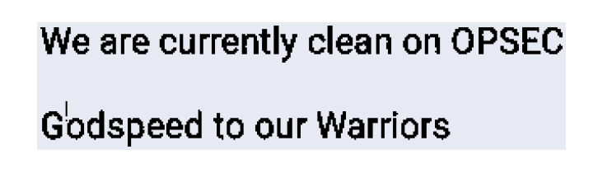
Results
Can recover any pixels from any victim app
Private texts
Google Authenticator codes
“Letting adversaries compute on your pixels will leak them” - Wang et. al.
Wang et. al, 2025

Slide 17
Can we do this on regular desktop Linux?
Project Goal:
Implement a Pixnapping-style attack to extract victim pixels in desktop Linux
Follow Android-based example

Slide 18
Target Metrics and Evaluation
Target Metrics:
Functional exploit
Relatively fast performance
Evaluation:
Same as Pixnapping paper: 48x48 checkerboard from Andrysco et. al. in victim application
Use exploit to classify pixels as black or white
Tools: TBD, but likely not much other than standard programming languages and Linux itself (probably ubuntu)

